Slide 1


K.RAMAKRISHNAN COLLEGE OF TECHNOLOGY
(AUTONOMOUS), TRICHY
MOVIE TICKET BOOKING SYSTEM
PRESENTED BY SUPERVISOR
KETHAAR ESHWAR A Mrs.K.ValliPriyadharshini M.E,PhD
2303811710421079 AP/CSE.

Slide 2
PRESENTATION OVERVIEW
Objective
Project Introduction
Problem Statement
Methodologies (Programming concepts relevant to problem statement)
Architecture of the proposed system
List of Modules
7. Merits
8. Results and Discussion
9. Queries

Slide 3
OBJECTIVE
The Movie Ticket Booking System features separate panels for users and admins. Users can book movie tickets by entering personal details and payment information, while admins can update movie details, view bookings, and manage notifications. The system includes a movie list with name, price, and show time, and implements authentication for admin login. Input validation is done for user details such as mobile numbers and payment amounts

Slide 4
PROJECT INTRODUCTION
The Movie Ticket Booking System is a Java-based application that allows users to book movie tickets while providing admins the ability to manage movie details and view bookings. It includes features such as input validation, a dynamic movie list, and admin authentication, with navigation between user and admin panels using CardLayout. The system also notifies admins of new bookings and provides an easy exit option.

Slide 5
PROBLEM STATEMENT
Traditional movie ticket booking systems face challenges like limited accessibility, inefficient management, and lack of real-time updates.Absence of real-time notifications for users about booking status or changes.

Slide 6
METHODOLOGY
1.Error Handling: Exception handling is used for input validation (e.g., invalid mobile numbers, non-numeric inputs).
2.Classes and Objects: Used to model key entities such as movies, users, and bookings. The Movie class represents movies, and arrays are used to manage booking history and notifications.
3.Java Collections Framework: ArrayLists are used to manage movie data, booking history, and admin notifications dynamically.

Slide 7
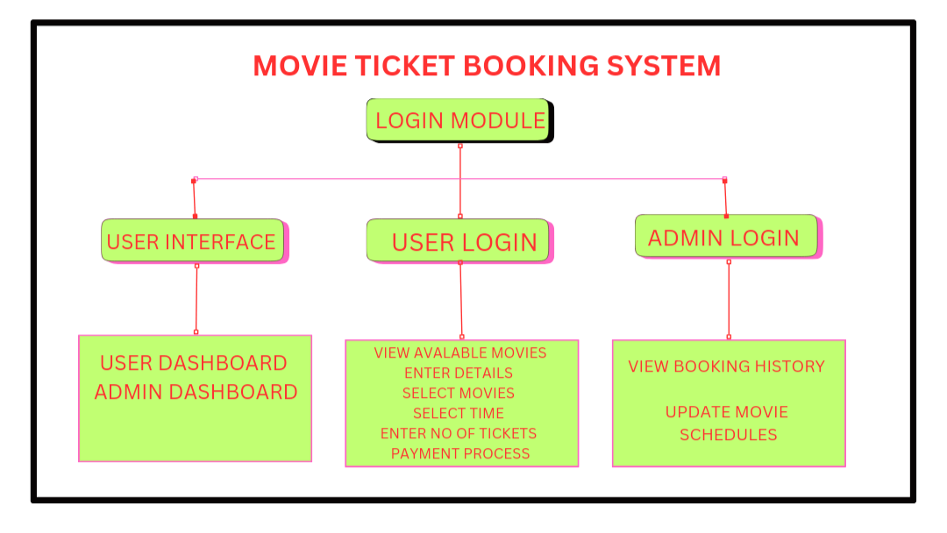
ARCHITECTURE DIAGRAM

Slide 8
LIST OF MODULES
Booking System Module: Allows users to book tickets by selecting a movie, entering user details, and calculating payment. It also tracks booking history .
Movie Management Module: Manages movie data such as name, price, and showtime, and provides functionality to update and display available movies.
User Interface Module: Handles the creation of graphical user interfaces using the Swing and AWT libraries, including panels, buttons, text fields, and labels for user and admin interactions.

Slide 9
MERITS
1.User-Friendly Interface: The system has an easy-to-use graphical interface for both users and admins .
2 .Secure admin Authentication: Ensures that only authorized users can access the admin panel through a login system.
3. Real-Time Movie Booking: Users can book tickets in real-time, view available movies, and select showtimes .
4. Payment Validation: Ensures correct payment processing by verifying the entered amount against the required payment

Slide 10
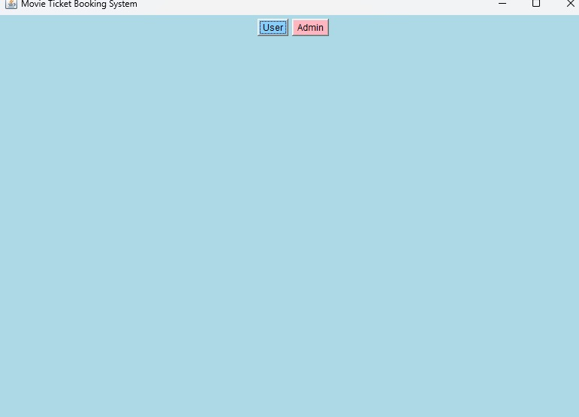
RESULTS AND DISCUSSION

Slide 11
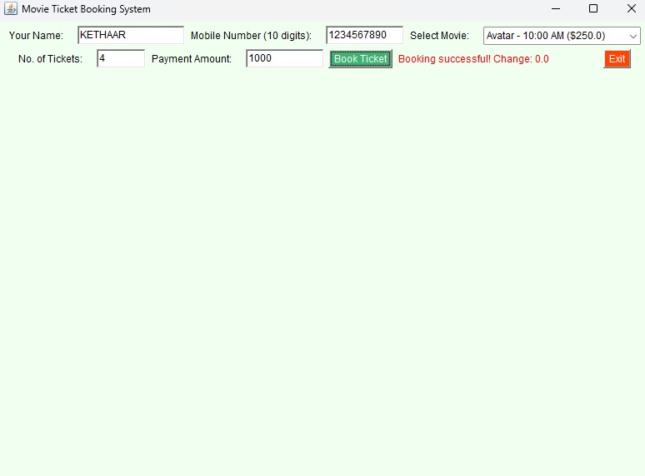
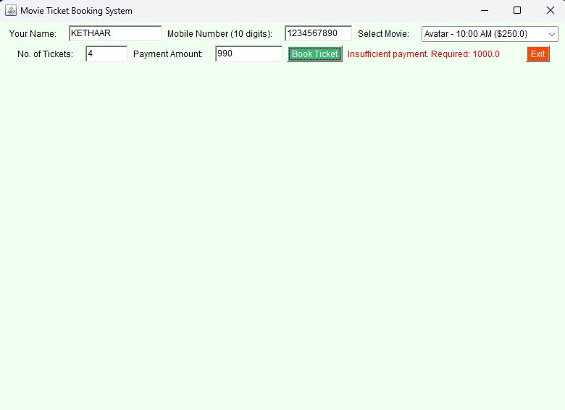

Slide 12


Slide 13
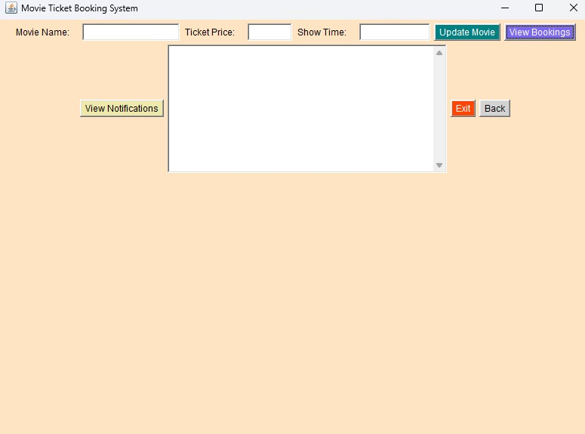

Slide 14
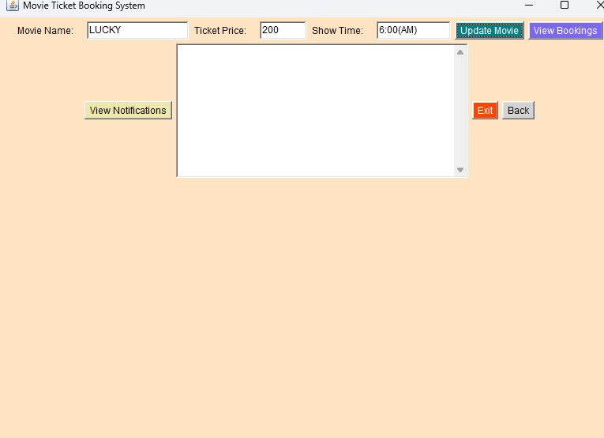

Slide 15
QUERIES

Slide 16
THANK YOU

